Slide 1
Garage Floor Coatings Product (Atlanta, DMA)

Slide 2
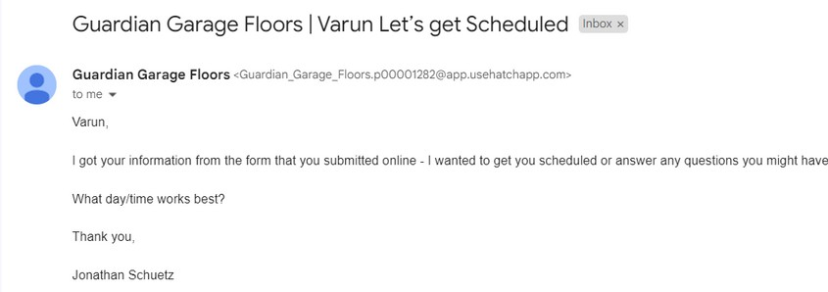
Top Contractors/Providers
Guardian garage floors
Epoxy Professionals
The painting pros
Angi Concrete services
Garage floor coatings of Atlanta
Nikka Corp
Badass Garage floors
KDL Painting

Slide 3

Busy Bob
Method of Selection
Gender- Male
Age-35-40
Occupation- Warehouse manager
Location- Atlanta,GA-30303
Martial Status- Married
Preferred method of Communication- Email, Fax, Telephone
Keyword Analysis and Traffic Analytics
Each competitor was reached through a buyer persona created which represent our target audience and the time of responsiveness and Traffic on their website was shortlisted
Buyer Description
He is in his early 30’s and has been a warehouse manager for a sports business
He is responsible for the material handling and logistics of the business
He is has been living in the Atlanta, DMA region for a period of 5 years
He has recently noticed that some repairs and coatings are required in the Atlanta, GA warehouse and he is looking for cheap and effective solution

Slide 4
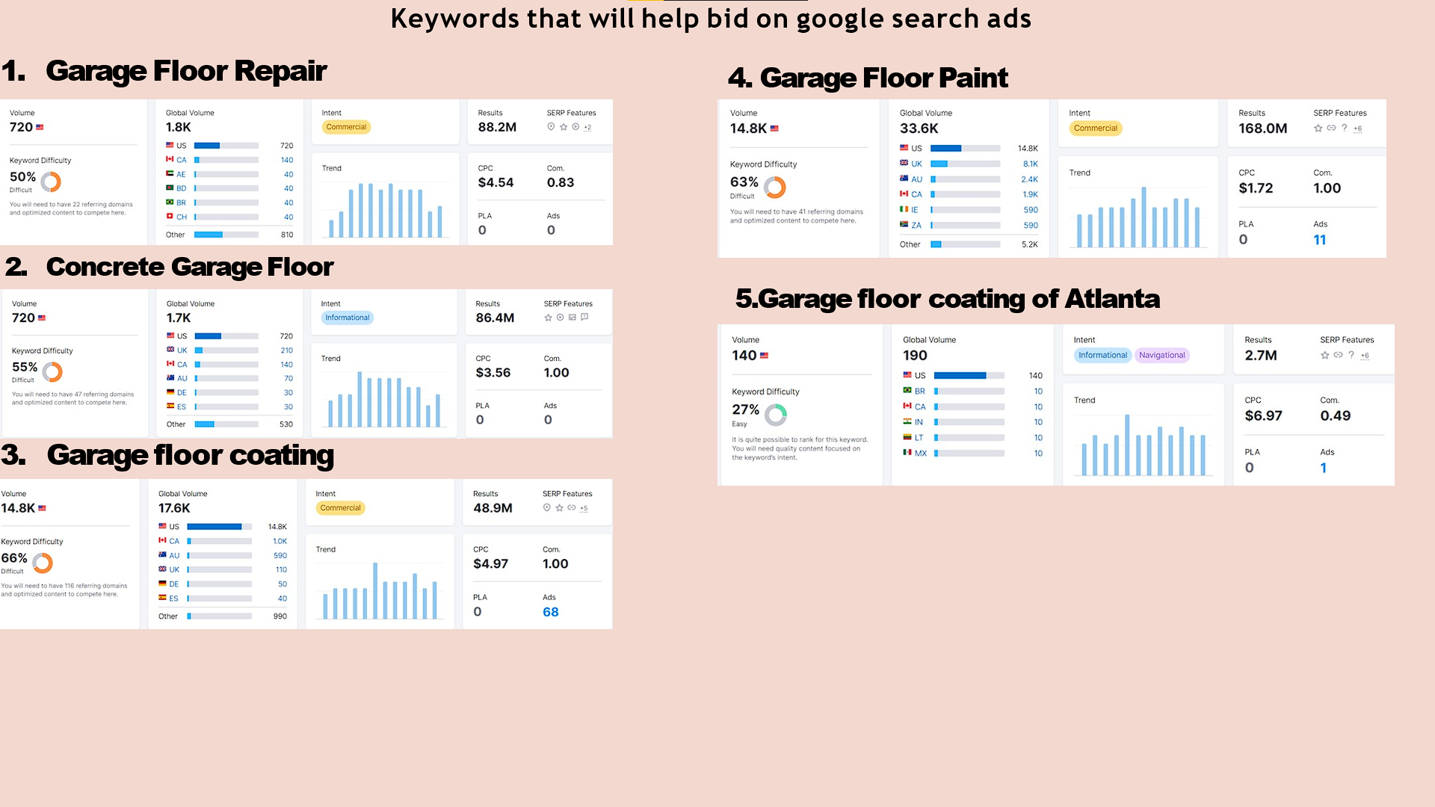

Slide 5
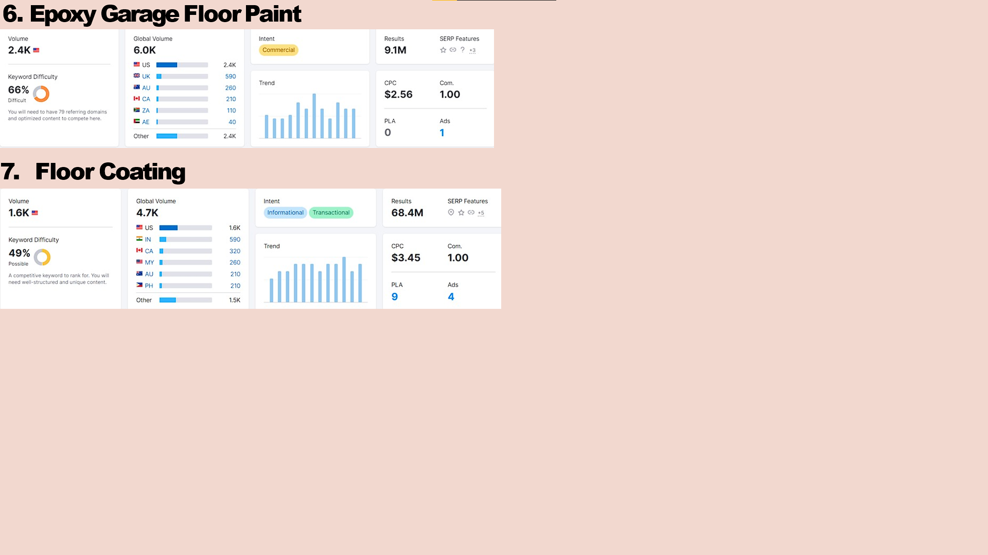

Slide 6
Target Customers / Zip code
place | zip
1st Choice Remodel ATL | 30326
Precision Epoxy Atlanta LLC | 30308
Guardian Garage Floor | 30102
Rejuvenate flooring | 30310
My home improvement | 30342
Atlanta Floor Coating | 30115
Epoxy Flooring Atlanta | 30316
All 4 seasons garage | 30062
Jordan’s Overhead Garage Door Service | 30312
Garage floor coating of atlanta | 30115
Atlanta Concrete Artisians | 30308
Sudlow Concrete Atlanta | 30319
Atlanta Custom Concrete | 30041
BadAss Garage Floors | 30328
Titanflooring | 30066
Grindkings flooring | 30066
ACC Facility Services | 30308
Georgia floor coating | 30062
1080 Floor Coating | 30269
Garage Expressions | 30078
Main focus: B2B Businesses/Marketing
Target customer: Top providers of garage floor coating/ Home contractors/ Renovators
Goal : Release product in paint shops/e-commerce giants
Reason for Selection of zip codes
Floor coating providers
Traffic Analytics
Organic paid search
Bidding on relatable keyword
Specializing in providing floor coating replacement.
Most ads traffic

Slide 7
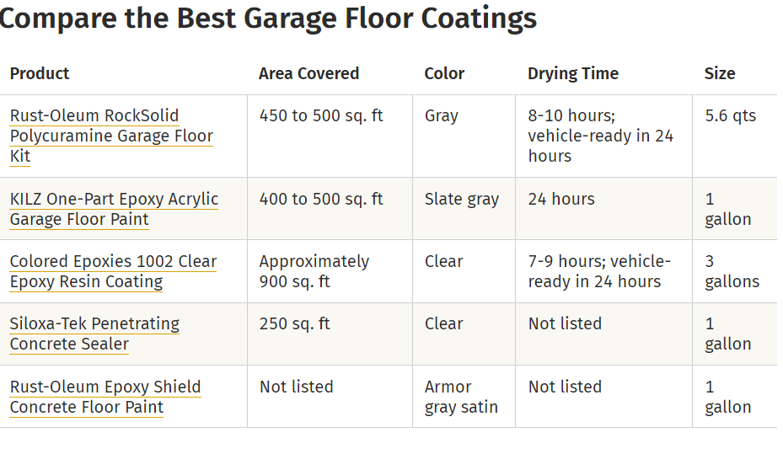
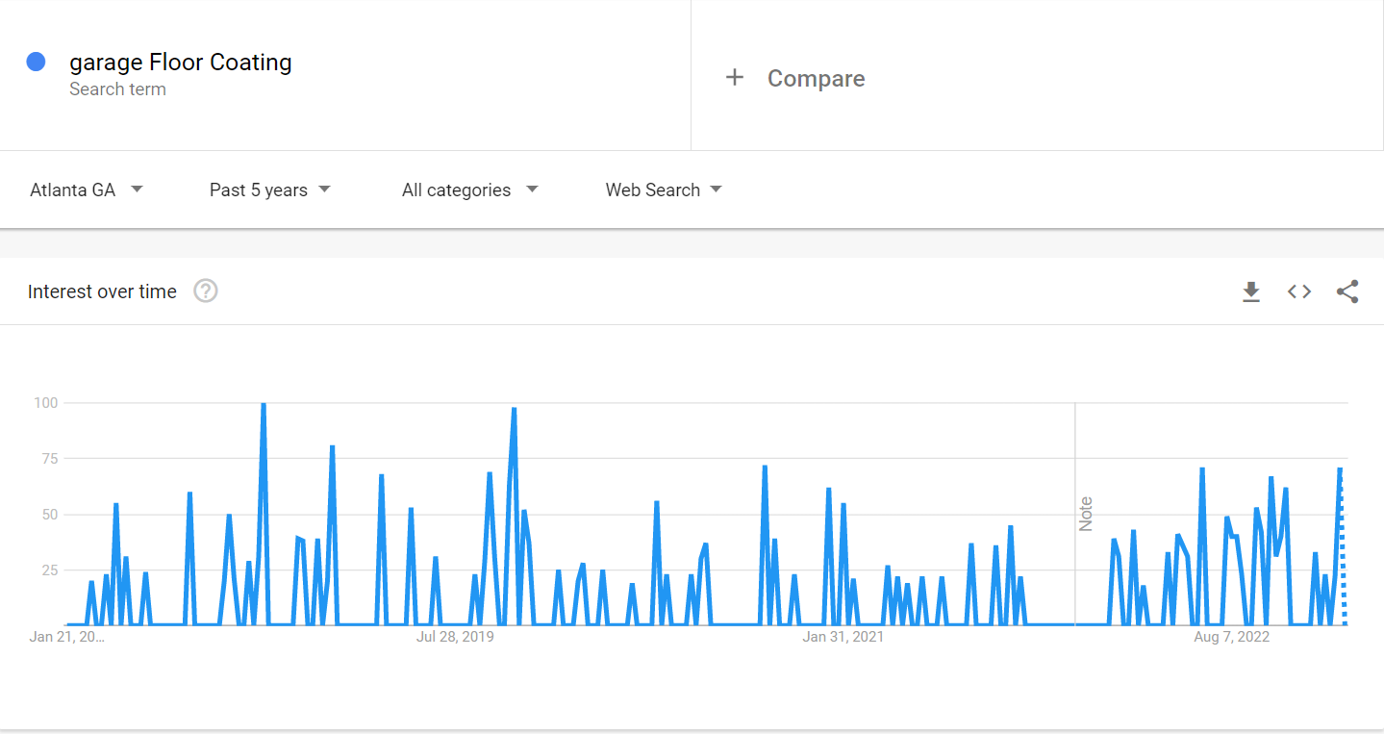
Most Ads Traffic related to garage floor coating Ad Traffic
All 4 seasons garages- 114,753
Home Advisor- 50,518
Jordan’s Overhead Garage Door Service- 23,383
Rock Solid Surfacing- 11,747
Will help us to refer from the competitive sources the type of ads that are effective among consumers
Searches for Garage Floor Coating in Atlanta, GA for the past 5 years/Google trends.

Slide 8
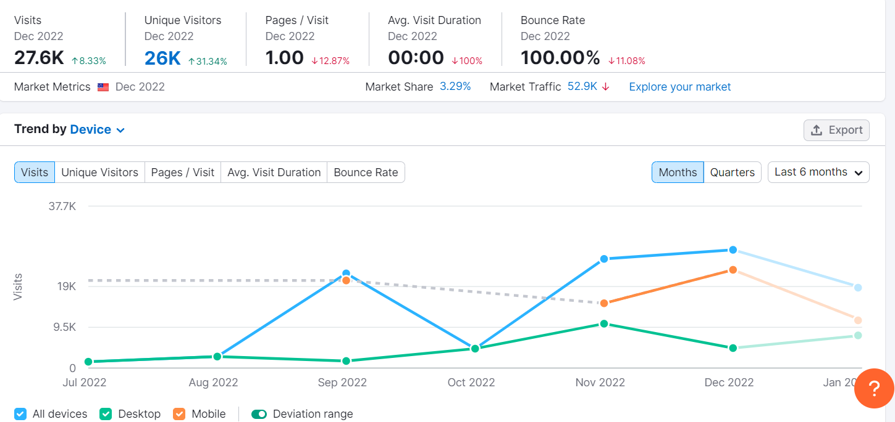
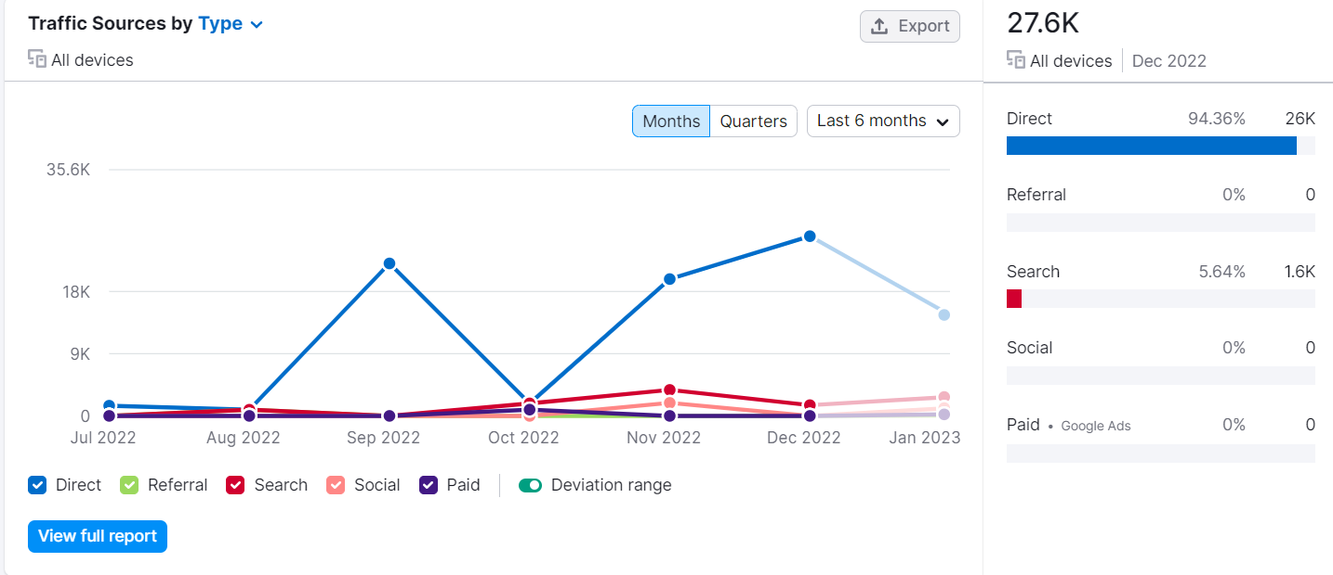
How did Renuity to manage this change ?
Visit increase from around 19k to 30k?
Why is direct source the main type of traffic source?

